Slide 1
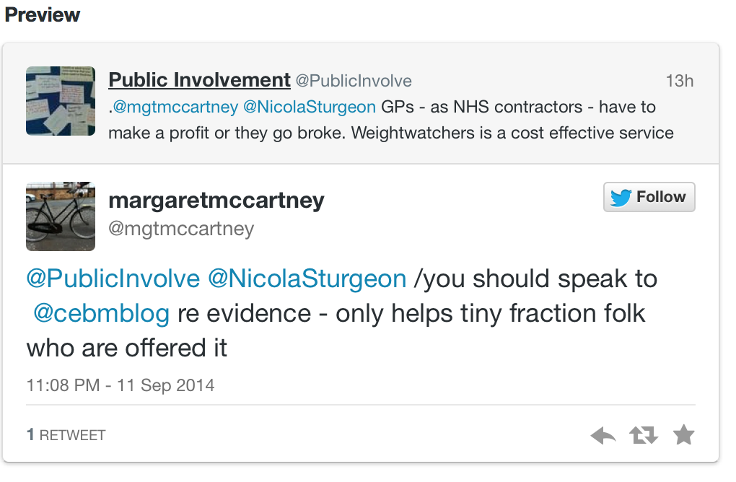
Most intervention don’t apply to the people we see in practice?
People invited to participate in weight watchers
Take up the invitation ¹
Attend all classes ²
6
Do not attend the first class ²
Do not attend all of the classes
Don’t take up an invitation
Weight loss 5.4 kg ³
At 2 years
people maintain their goal weight ⁴
At 5 years ⁴
(9 women and 1 man) maintain their goal weight
At 1 year lose an average of 2.5 kg
Weight Watchers
Jolly et al (BMJ): the response rate to the invitation was 11.5%
Ahern et al (BMC Public Health): 54% of courses were completed
Ahern at al (BMC Public Health): median weight change was 5.4kg in those that completed the course
Lowe MR (BJN) The percentage of participants who remained below their goal wait at 2 and 5 years was 20.5% and 16.2% respectively

